Slide 1
Receptors
Mechanoreceptors: Detect mechanical compression or stretching of the receptor of tissues adjacent to the receptor
Thermoreceptors: Detect changes in temperature (cold/warmth)
Nociceptors: Pain receptors
Electromagnetic receptors: Detect light
Chemoreceptors: Detect taste, smell, oxygen level in blood, osmolality (electrolyte-water balance) of the fluids, CO2 concentrations etc.

Slide 2
Vision and visual receptors
Basic structure of the eye
Blind spot
Formation of an image on retina
Farsightedness (hyperopia/hypermetropia) and Nearsightedness (myopia)
Intraocular fluid, tonometer, and glucoma
Photochemistry of vision by rods and cons cells
Night blindness
Colour vision in reptiles and birds

Slide 3
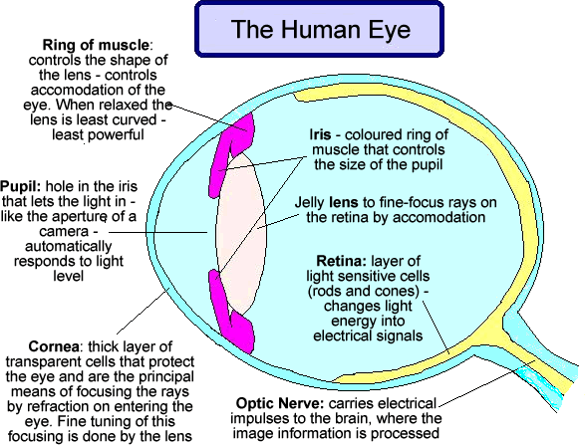
Human Eye: Structure & Functions:

Slide 4
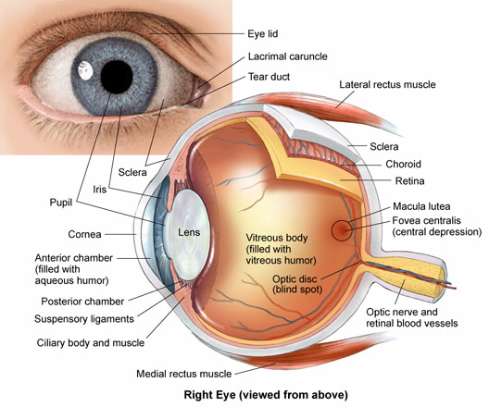

Slide 5
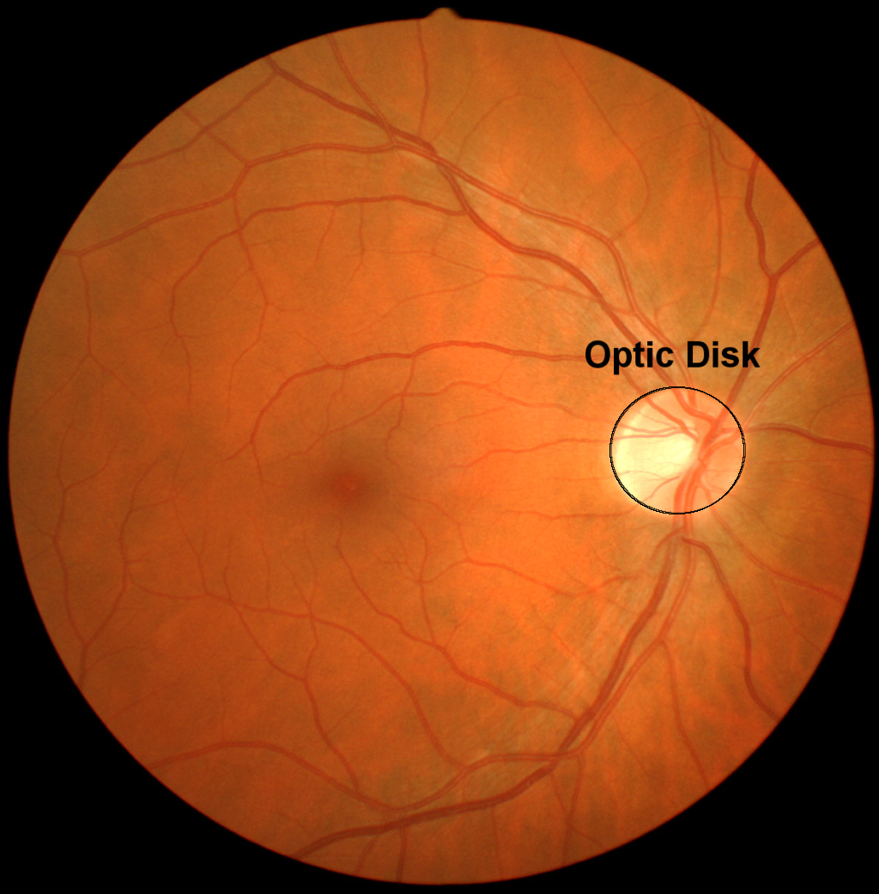
Blind Spot (Optic Disc)
contains no photoreceptors, i.e. no rods or cones overlying the optic disc.
entry point for the major blood vessels that supply the retina.
represents the beginning of the optic nerve.
carries 1–1.2 million afferent nerve fibres from the eye towards the brain.

Slide 6
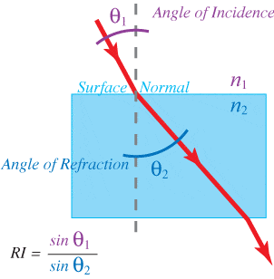
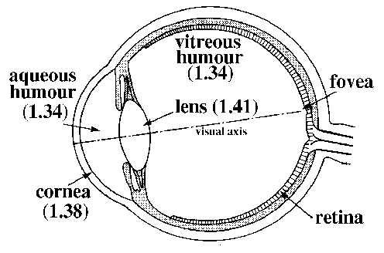
The lens system of eye is composed of four refractive interfaces:
The interface between air and the anterior surface of the cornea,
The interface between the posterior surface of the cornea and the aqueous humor,
The interface between the aqueous humor and the anterior surface of the crystalline lens of the eye, and
The interface between the posterior surface of the lens and the vitreous humor.
Refractive Index (RI)
Air: 1
Cornea: 1.38
Aqueous humor: 1.34
Crystalline lens (on average): 1.41
Vitreous humor: 1.34

Slide 7
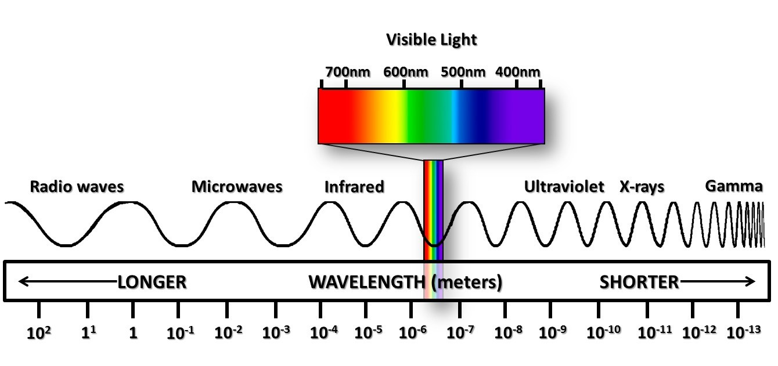
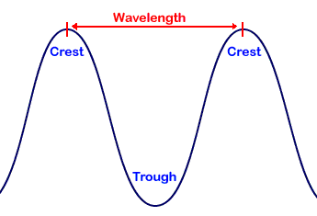
The Electromagnetic Spectrum:

Slide 8
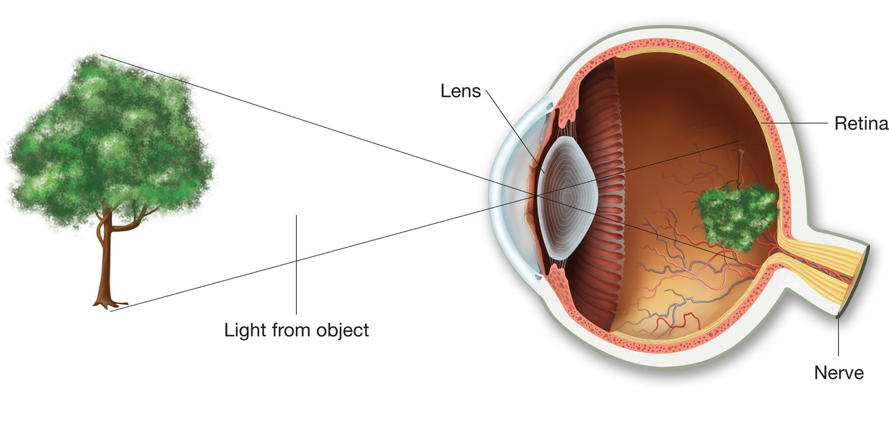
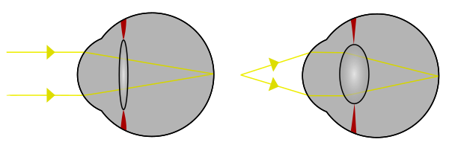
Image formation:
Far object
Near object
Inverted image

Slide 9
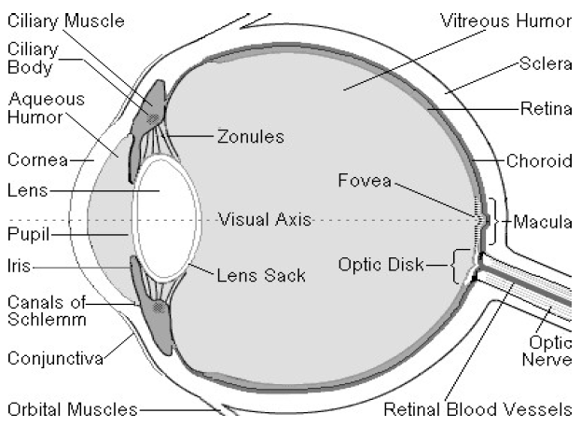
The eye as a camera:
▪ A lens system,
▪ A variable aperture system (the pupil)
▪ A film (the retina)
Pupil works like aperture

